Slide 1
UNIT-5
Pure React

Slide 2
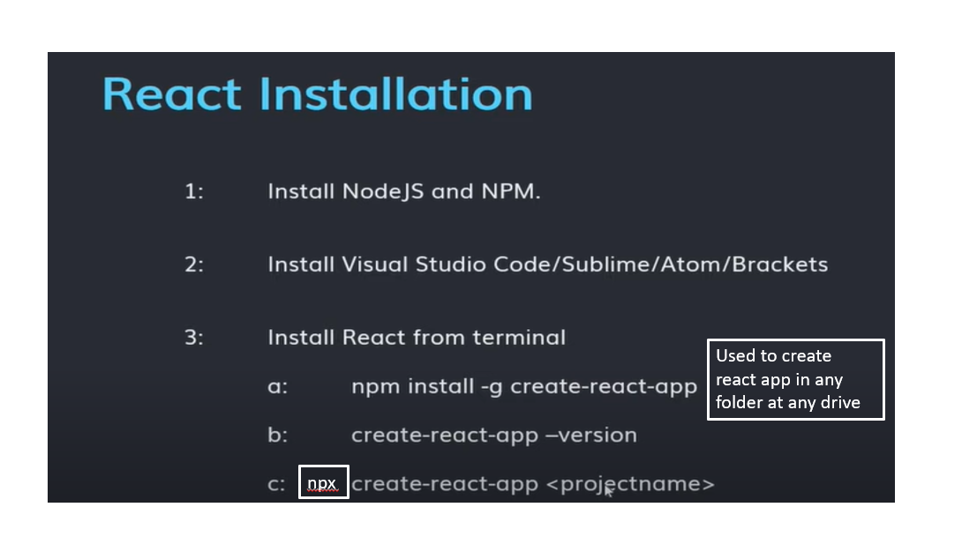

Slide 3
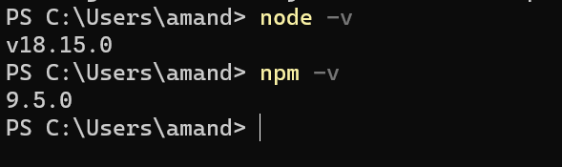
Version Checking

Slide 4
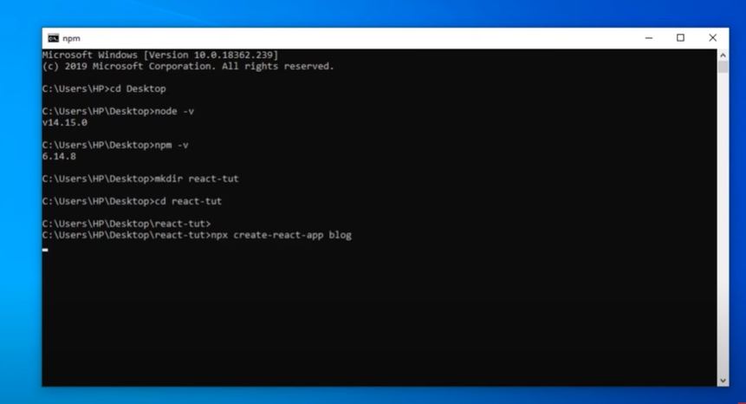

Slide 5
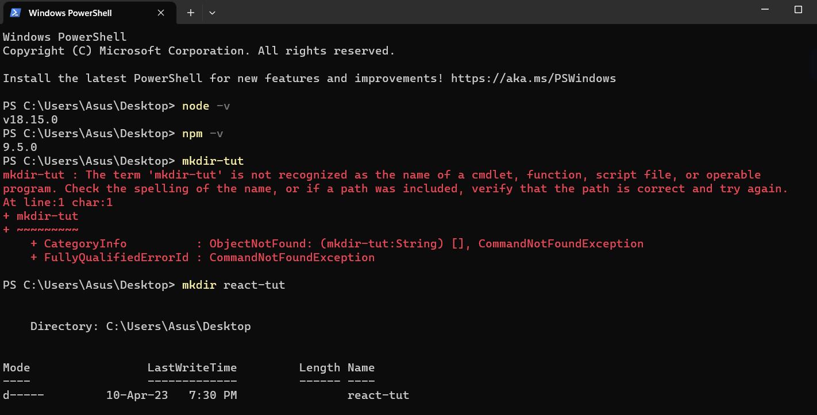

Slide 6
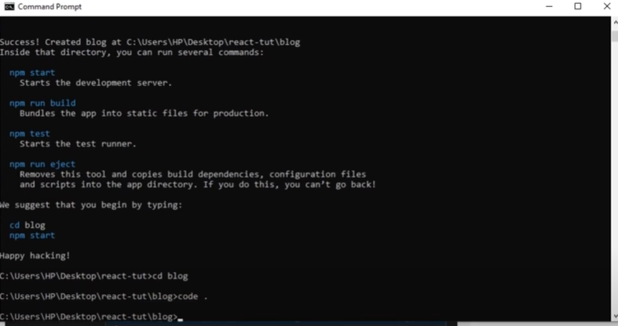

Slide 7
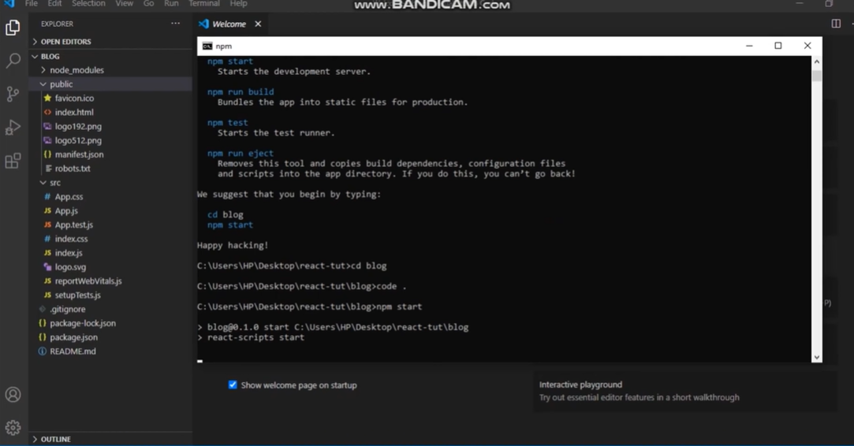

Slide 8
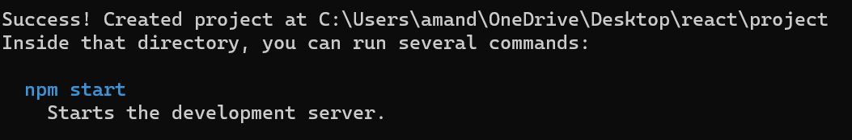
TO START THE REACT SERVER

Slide 9
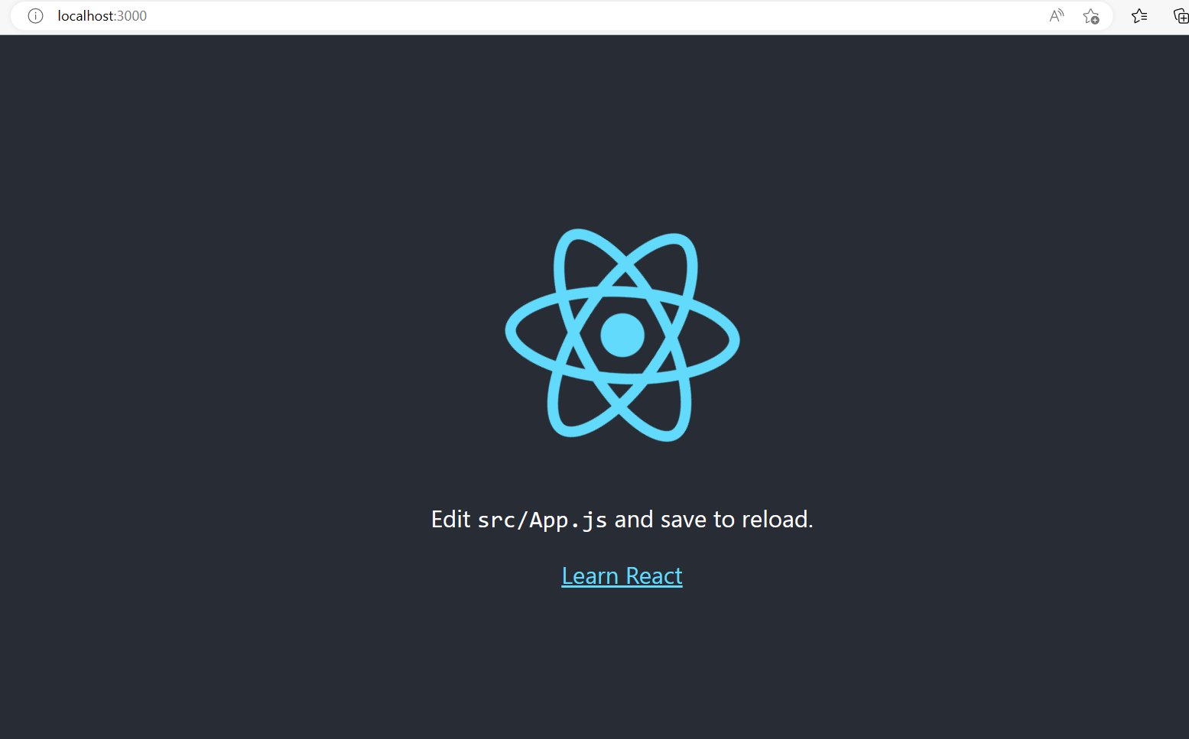

Slide 10
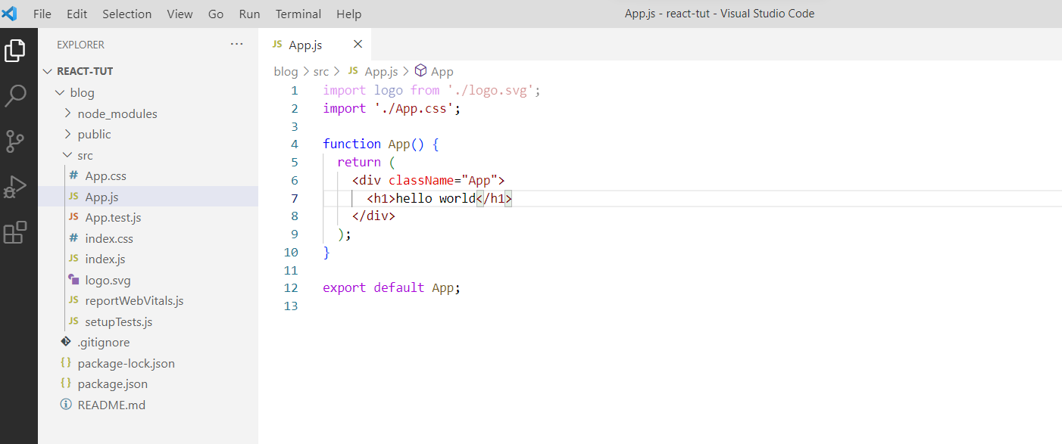

Slide 11
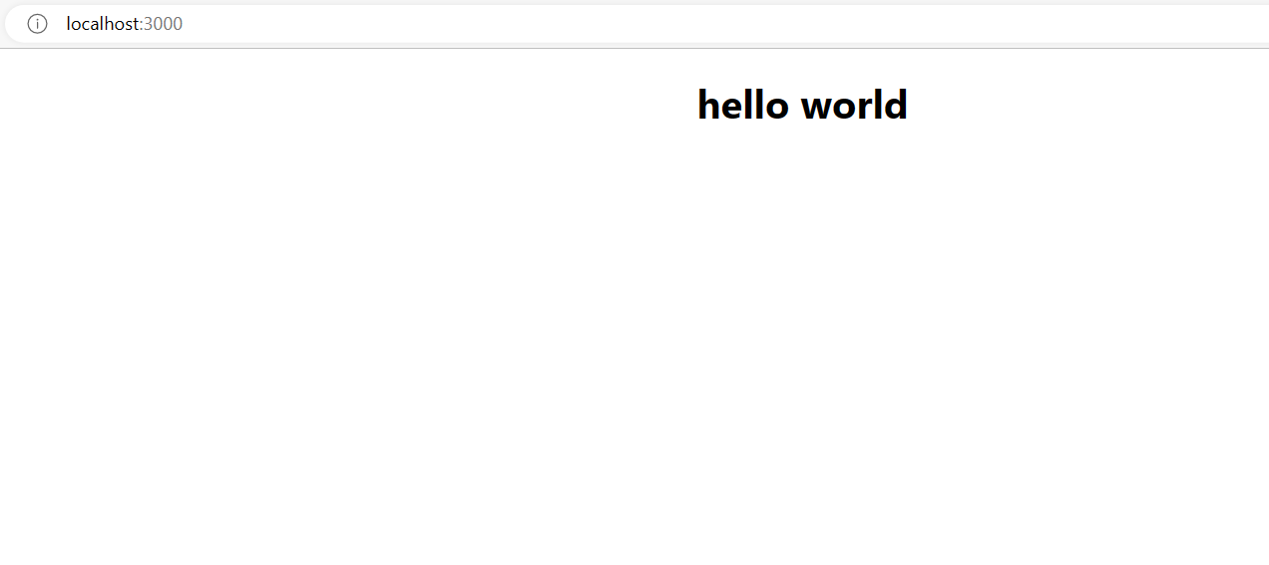

Slide 12
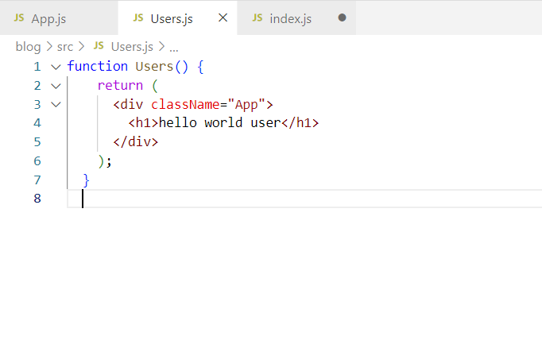

Slide 13
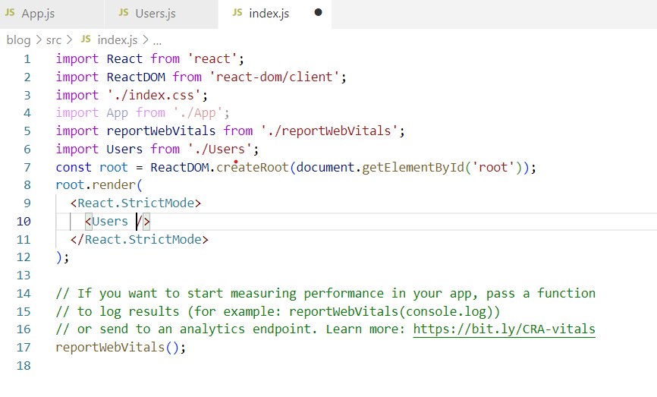

Slide 14
Setup
Setup Test.js
Serviceworker.js
Logo.svg
Gitignore
Package.lock.\js
App.js
App.css
App.test.js
Robot
Manifest
favicon
These files can be delete
Task- what is <noscript>

Slide 15
Page Setup
To work with React two libraries we need to import
React
React DOM
Both can be used with the help of CDN
React Library is used to create views
React Dom is used for the UI in the Browser.

Slide 16
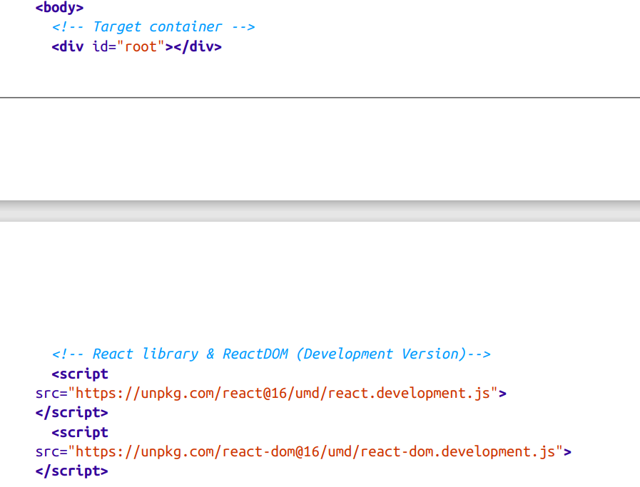
IMPORTING CDN’s

Slide 17
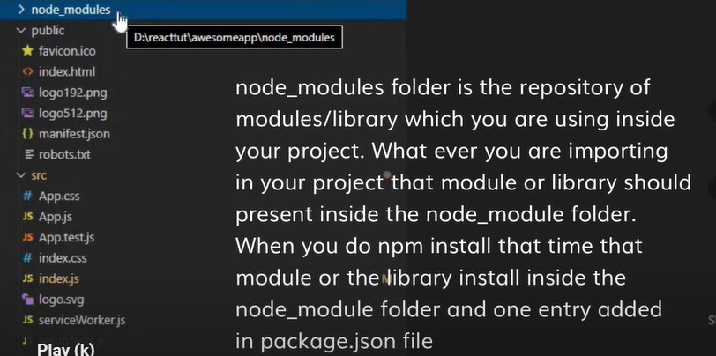
Files in React-
Package.json- contain information regarding name, version, private, reflect how many dependencies are there in this react’s project.
If to share the project with someone just you need to share package.json because it contain version used in the project.

Slide 18
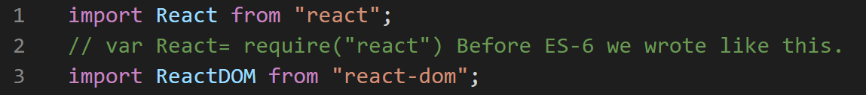
Importing the files

Slide 19
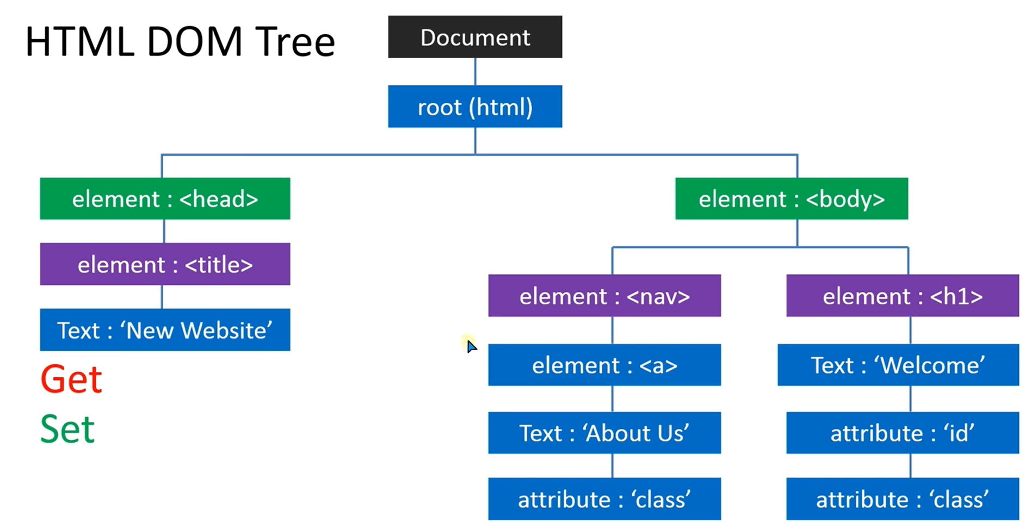
HTML DOM is basically used to create the Nodes.
To get the value from the HTML Document
To set the value in HRML Document changing class name, changing Text.
NOTE- With the Help of DOM you can add HTML Element or delete the HTML element.

Slide 20
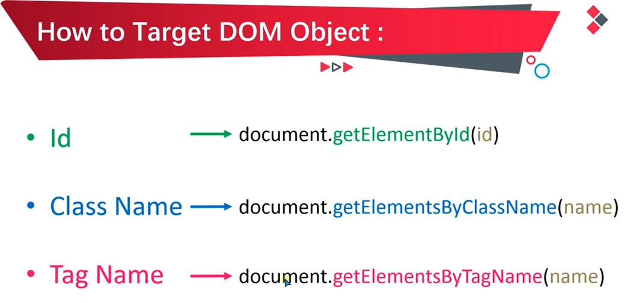

Slide 21

Virtual DOM
What is DOM ?
Document ➔ HTML Document File
Object ➔ title, body, url
Model ➔ Collection and arrangement of HTML tags
If to call a particular object of a document [document.title]
It will display the content of a title
Calling the particular object of the class.

Slide 22
Virtual DOM
In every javascript DOM having corresponding virtual DOM.
Virtual DOM is basically the clone of the DOM.
If any changes done in the DOM, it should be done in virtual DOM instead of doing in real/original DOM.
If heavy changes/ maximum changes is in the single tag then that changes will be done in virtual DOM then it will render after that final changes done in the real DOM.

Slide 23
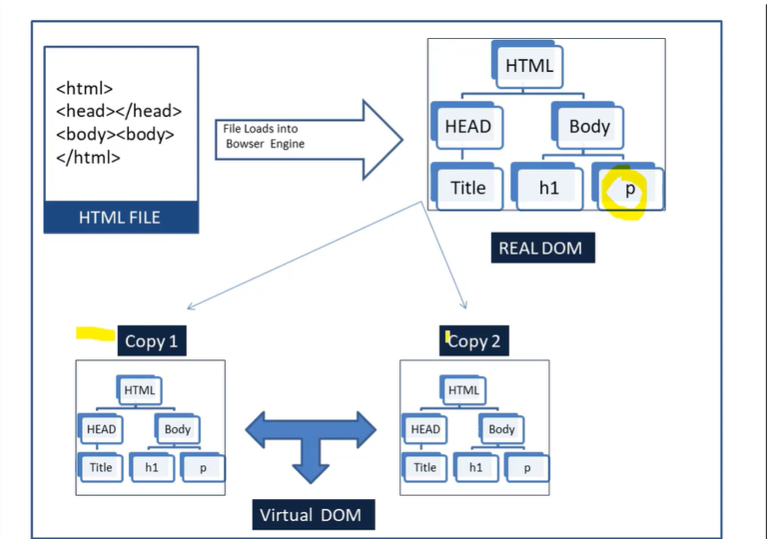

Slide 24
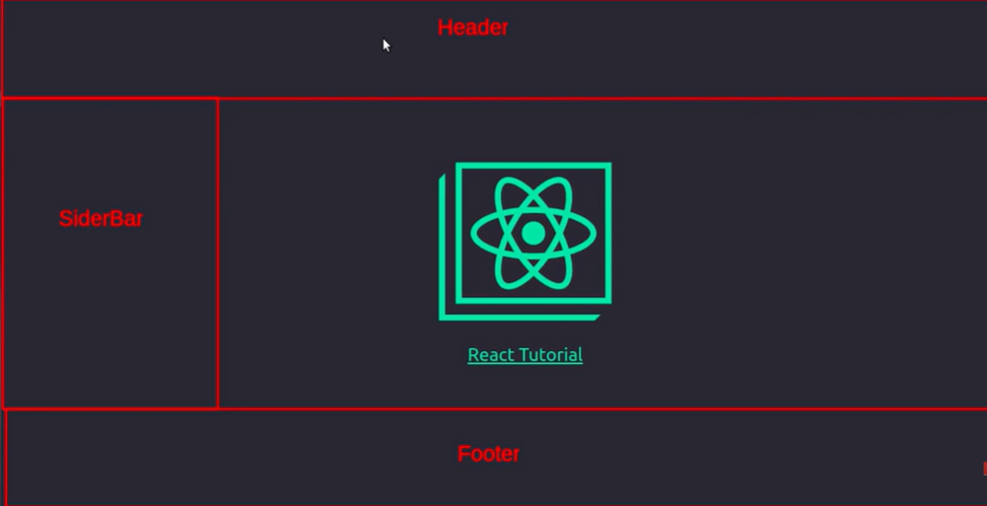
React Component

Slide 25
React Component
Components are independent and reusable bits of code.
They serve the same purpose as JavaScript functions, but work in isolation and return HTML.
Components come in two types, Class components and Function components.
Basically components can be reused many times.
There is no need to rewrite the coding.

Slide 26
React Component

Slide 27
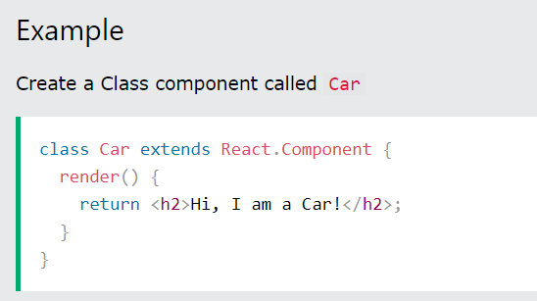
Class Component
A class component must include the extends React.Component statement. This statement creates an inheritance to React.Component, and gives your component access to React.Component's functions.
The component also requires a render() method, this method returns HTML.

Slide 28
React Component
import React from 'react'
export default extends React.component{
render()
{
return(
<div>
<h1>Home component</h1>
</div>)
}
}

Slide 29
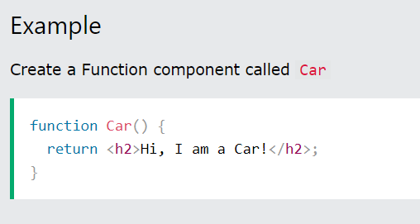
Function Component
Here is the same example as above, but created using a Function component instead.
A Function component also returns HTML, and behaves much the same way as a Class component, but Function components can be written using much less code, are easier to understand, and will be preferred in this tutorial.

Slide 30
React Elements
The React DOM is made up of React elements.
React elements are the instructions for how the browser DOM should be created.
We can create a React element using React.createElement:
CreateElement method takes few parameters.
First one is the type of Element we want to create like h1 or h2 or div.
Second parameter specifies the Properties we want to apply to this element.
Third one represents the Child Element or Elements that has be placed inside the Parent one.
const element = React.createElement("h1",null,'Hello World');

Slide 31
What is Babel
Babel is an JavaScript Compiler.
It is mainly used to convert ECHMA script 2015 + code into a backward compatible version of JavaScript in current and old version of browsers or environment.
When we create an app by using “create-react-app” then babel automatically included in our reactapp.
Babel can convert JSX Syntax.

Slide 32
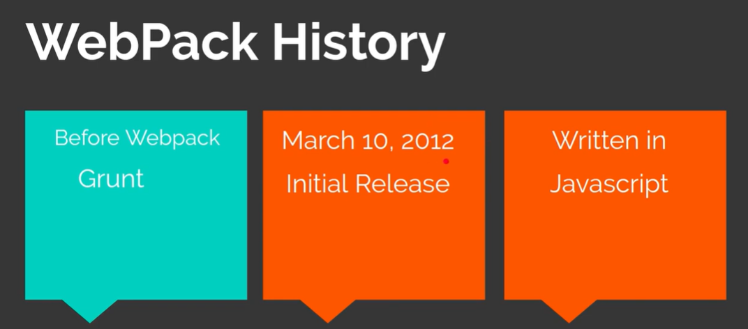
Webpack

Slide 33
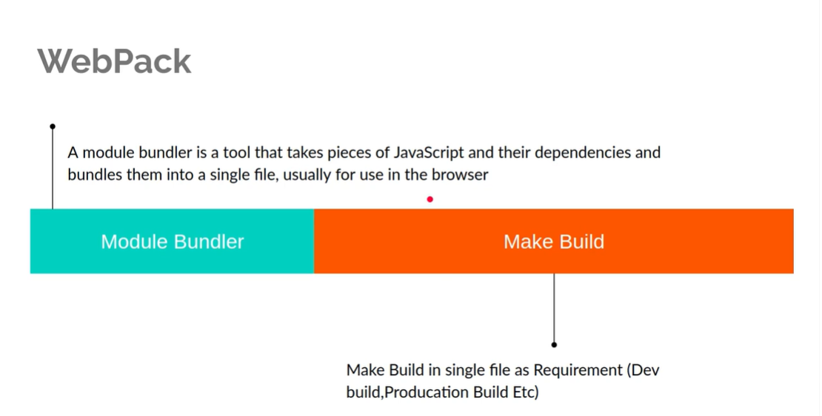

Slide 34
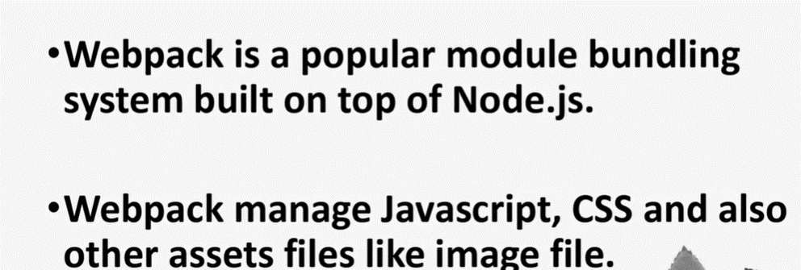

Slide 35
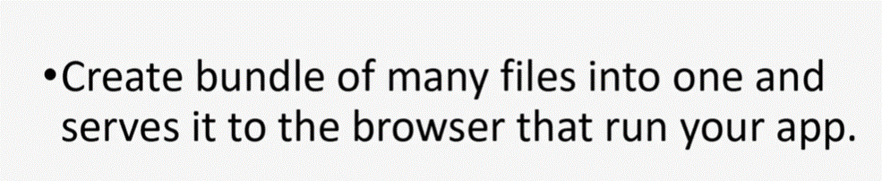
Use of Webpack

Slide 36
Constructing Elements with Data
The major advantage of using React is its ability to separate data from UI elements. Since React is just JavaScript, we can add JavaScript logic to help us build the React component tree. For example, ingredients can be stored in an array, and we can map that array to the React elements.

Slide 37
